Slide 1
DNA isolation and purification
Notes:
Refer TA Brown Book
Also- Those who want to learn the detailed list of Dna isolation kits for isolation from various sources and their yield etc may refer https://www.labome.com/method/DNA-Extraction-and-Purification.html

Slide 2
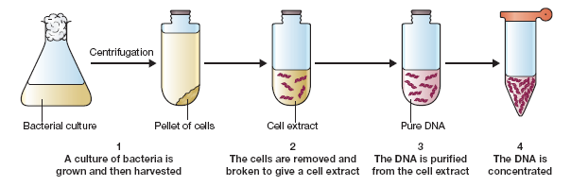
3.1 Preparation of total cell DNA
3.2 Preparation of plasmid DNA
3.3 Preparation of bacteriophage DNA

Slide 3
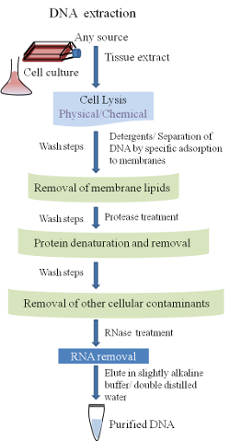
Source
Mammalian Cells/Tissues, Blood, Fecal, Hair, forensic
Bacteria, spores etc
Fungi
Algae
Yeast
Plants
Insect
(Fresh, Frozen, FFPE)
Notes:
FFPE Tissues. Formalin-fixed paraffin-embedded

Slide 4
Methods
Organic Extraction
Silica Based Technology
Magnetic Separation
Anion Exchange Technology
For a pure DNA sample, the ratio of absorbance at 260 nm and absorbance at 280 nm (A260/A280) is 1.8. A ratio of < 1.8 indicates the sample is contaminated with protein or an organic solvent such as phenol, often used during extraction processes.

Slide 5
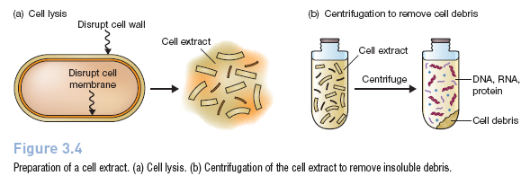
Preparation of Cell Extract
Lysozyme- digests the polymeric compounds that give the cell wall its rigidity.
EDTA removes magnesium ions that are essential for preserving the overall structure of the cell envelope, and also inhibits cellular enzymes that could degrade DNA
SDS-Detergents aid the process of lysis by removing lipid molecules and thereby cause disruption of the cell membranes

Slide 6
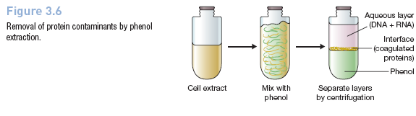
Preparation of DNA from Cell Extract-Organic extraction or Enzyme digestion
Phenol, chloroform, proteinase K, RNAse

Slide 7
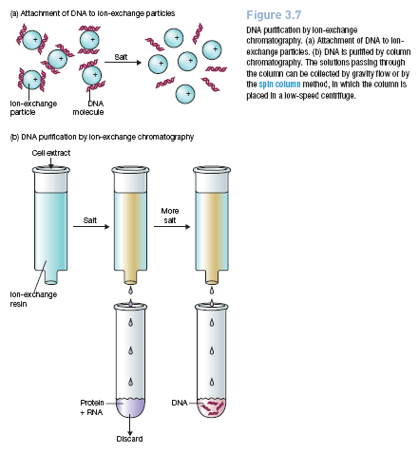
Purification of DNA from Cell Extract-Ion Exchange Chromatography
DNA binds specifically to the substrate in the presence of low salt, contaminants are removed by wash steps using a low or medium salt buffer, and purified DNA is eluted using a high salt buffer

Slide 8
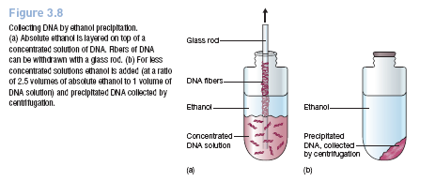
Concentration of DNA samples
absorbance is measured at 260 nm, at which wavelength an absorbance
(A260) of 1.0 corresponds to 50 mg of double-stranded DNA per ml.
With a pure sample of DNA, the ratio of the absorbances at 260 and 280 nm (A260/A280) is 1.8. Ratios of less than 1.8 indicate that the preparation is contaminated, either with protein or with phenol.

Slide 9
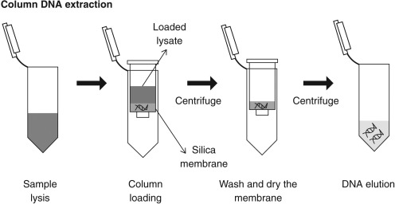
Silica Membrane

Slide 10
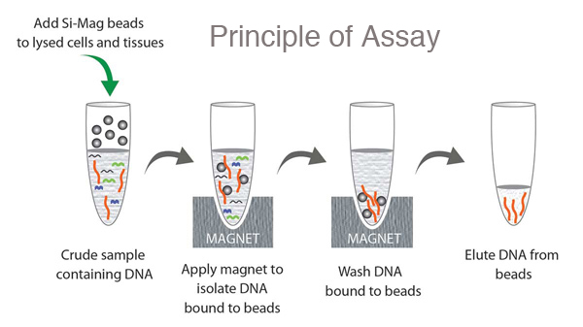
Magnetic Separation
Magnetic beads are made up of tiny (20 to 30 nm) particles of iron oxides, such as magnetite (Fe3O4), which give them superparamagnetic properties.
Superparamagnetic beads are different to more common ferromagnets in that they exhibit magnetic behavior only in the presence of an external magnetic field. This property is dependent on the small size of the particles in the beads, and enables the beads to be separated in suspension, along with anything they are bound to. Since they don’t attract each other outside of a magnetic field, they can be used without any concern about unwanted clumping.
https://www.cytivalifesciences.com/en/us/news-center/magnetic-beads-a-simple-guide-10001

Slide 11
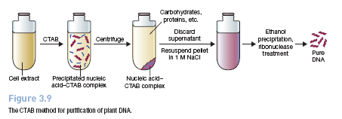
Plant DNA isolation
cetyltrimethylammonium bromide (CTAB)

Slide 12
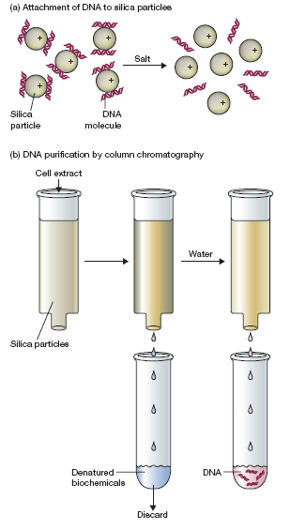
Guanidium Thiocyanate
Guanidinium thiocyanate, has two properties that make it useful for DNA purification. First, it denatures and dissolves all biochemicals other than nucleic acids and can therefore be used to release DNA from virtually any type of cell or tissue. Second, in the presence of guanidinium thiocyanate, DNA binds tightly to silica particles

Slide 13
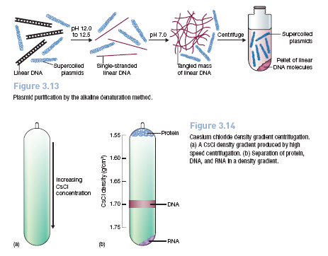
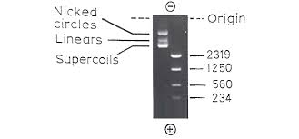
Plasmid Isolation
Notes:
https://bitesizebio.com/180/the-basics-how-alkaline-lysis-works/

Slide 14
CsCl Density Gradient Centrifugation
Notes:
https://bitesizebio.com/180/the-basics-how-alkaline-lysis-works/

Slide 15
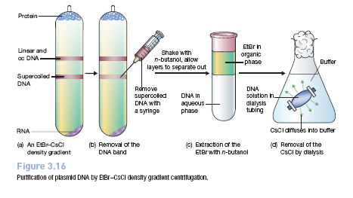
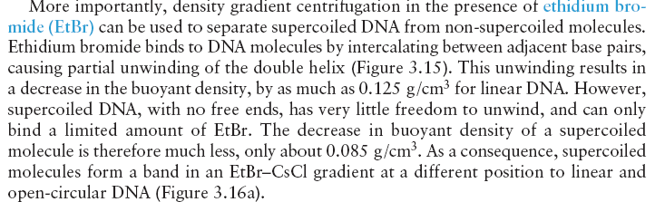
EtBr-CsCl Density Gradient Centrifugation Plasmid DNA Purification
Notes:
In isopycnic separation, also called buoyant or equilibrium separation, particles are separated solely on the basis of their density. Particle size only affects the rate at which particles move until their density is the same as the surrounding gradient medium.

Slide 17
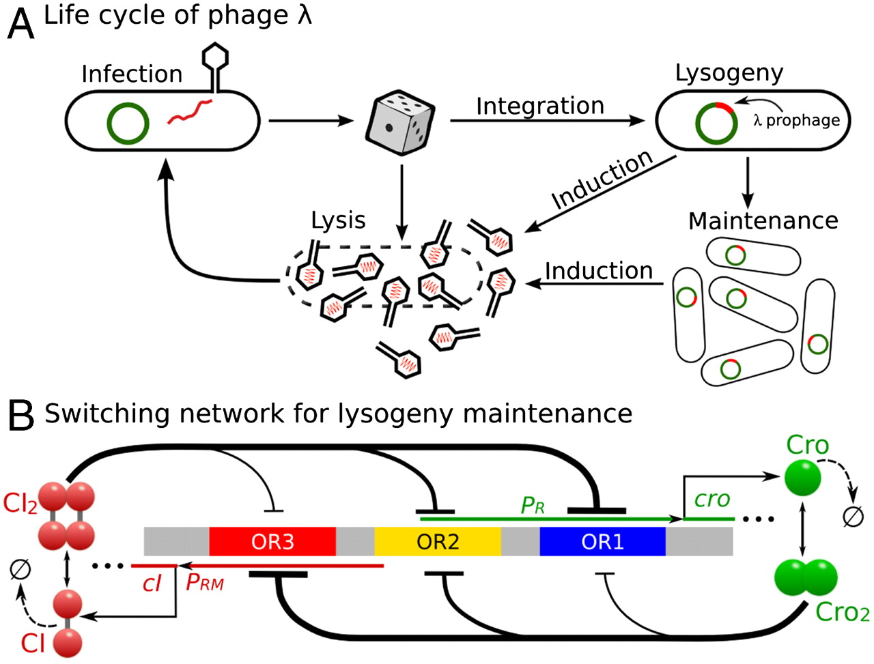
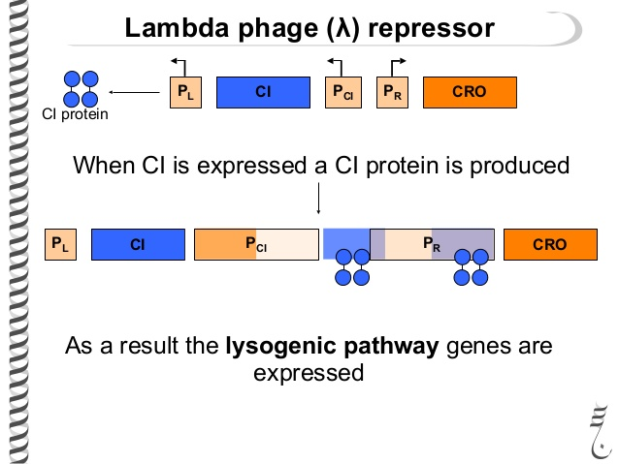
Lambda Phage

Slide 18
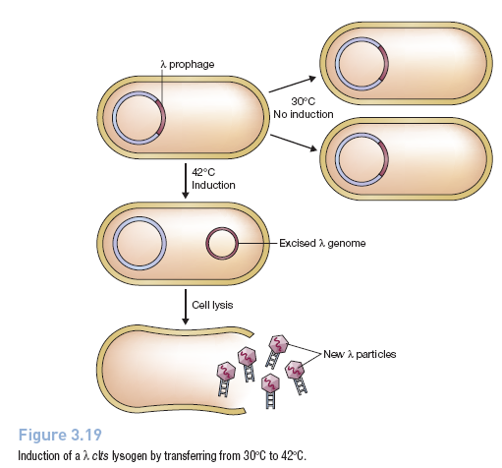

Slide 19
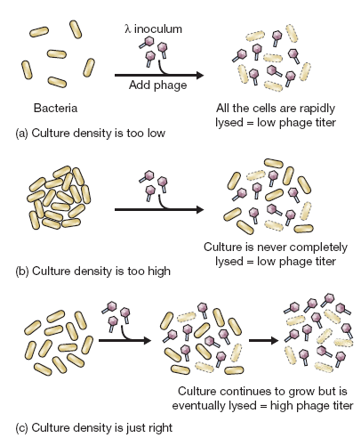
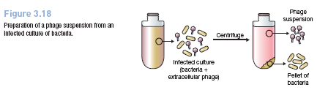
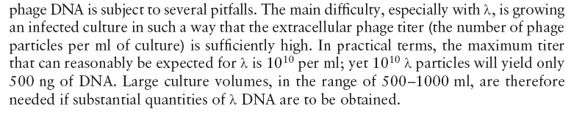
Lambda Phage Isolation

Slide 20
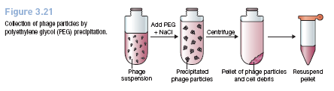
Lambda Phage Isolation
Phage particles are so small that they are pelleted only by very high speed centrifugation.
Collection of phages is therefore usually achieved by precipitation with polyethylene
glycol (PEG). This is a long-chain polymeric compound which, in the presence of
salt, absorbs water, thereby causing macromolecular assemblies such as phage particles to precipitate. The precipitate can then be collected by centrifugation, and redissolved in a suitably small volume (Figure 3.21).

Slide 21
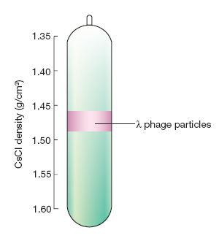
CsCL purification of Lambda Phage

Slide 22
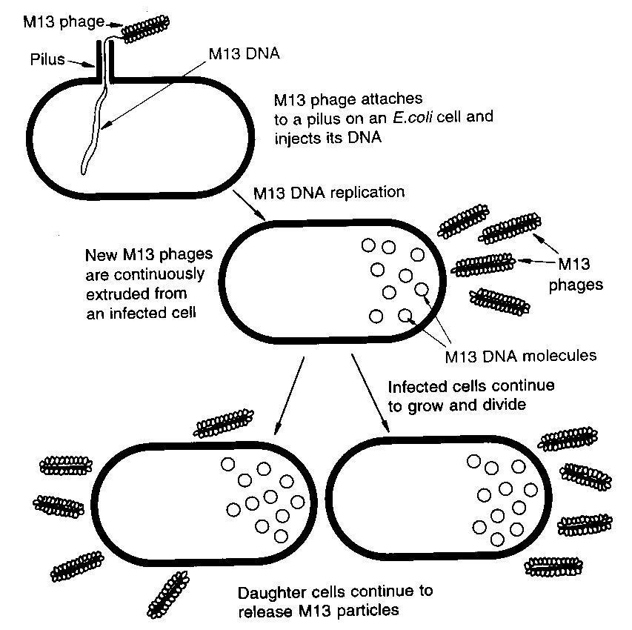
M13 phage DNA

Slide 23
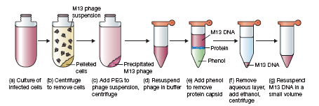
M13 phage DNA preparation

